Slide 1
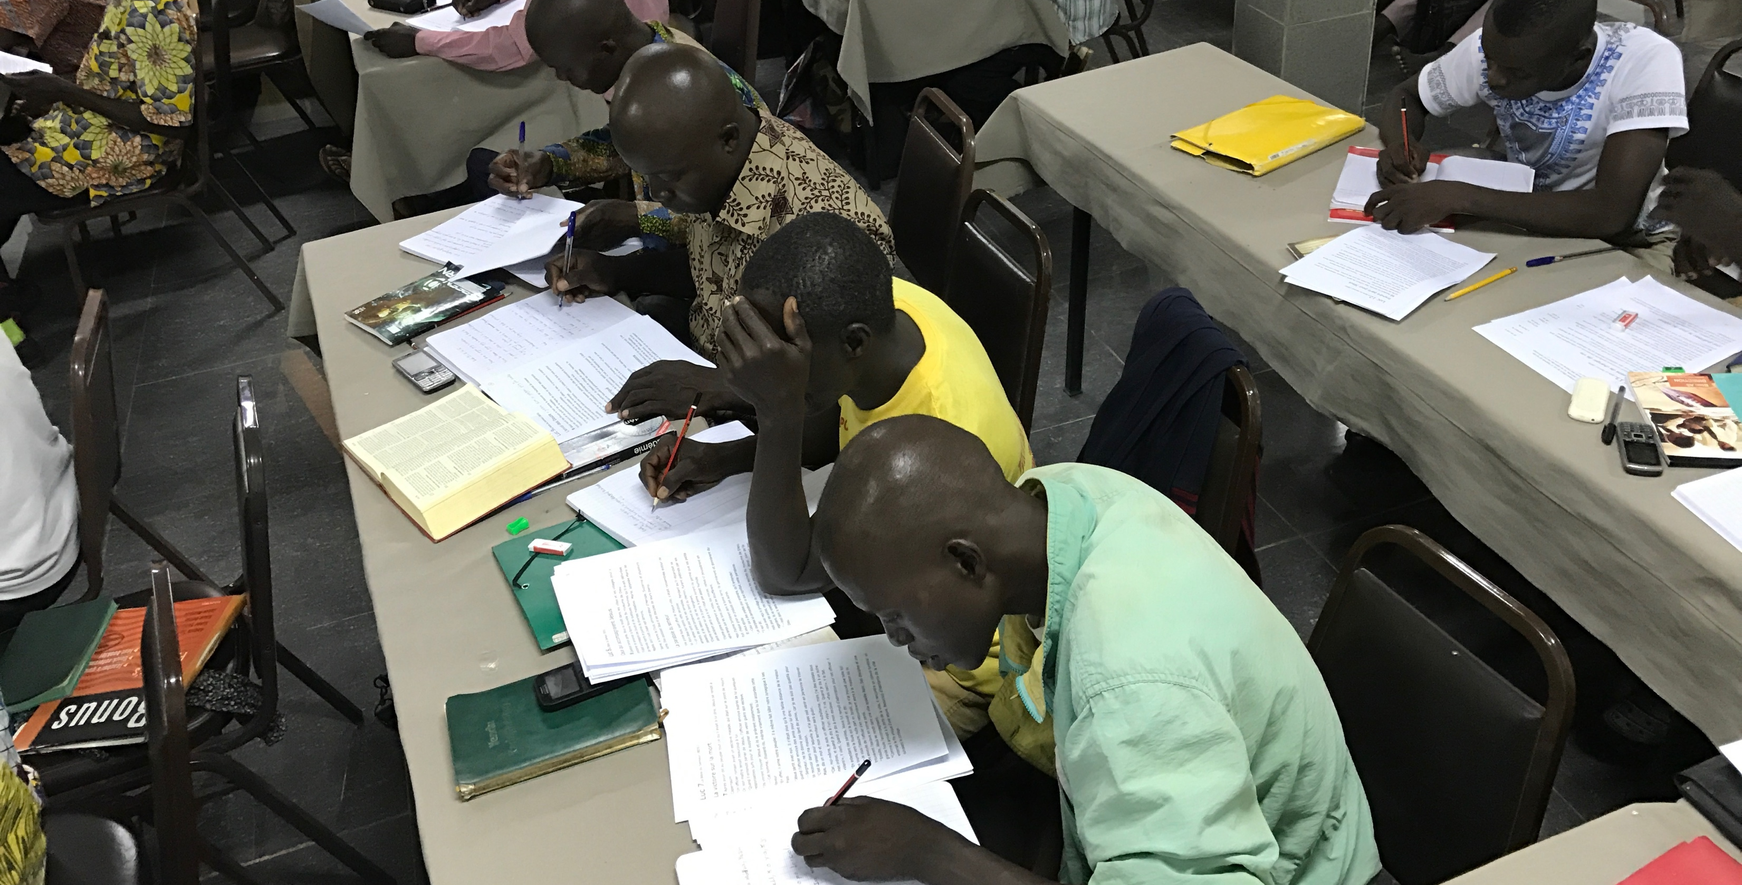
4 Beliefs
Church Owned Bible Translation

Slide 2
?
What do you think “Church-Owned” Bible Translation means?

Slide 3
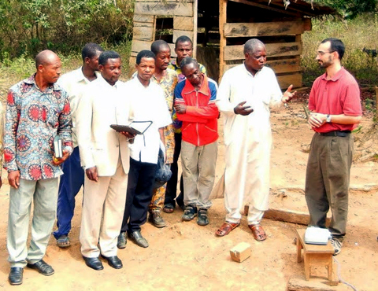
Ability
Local believers:
Know their language and culture
Have shared meaning through oral translation

Slide 4
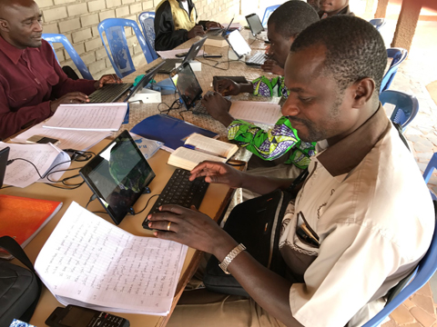
Ability
Authority
God’s Spirit gives the local church:
Wisdom
Authority

Slide 5
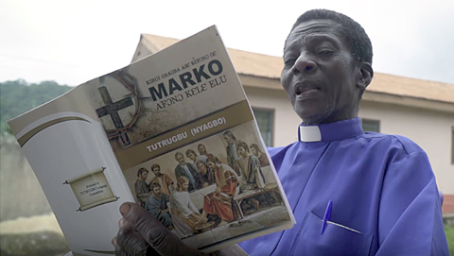
Ability
Authority
Responsibility
The local church is responsible for:
Evangelism
Discipleship
Bible translation

Slide 6
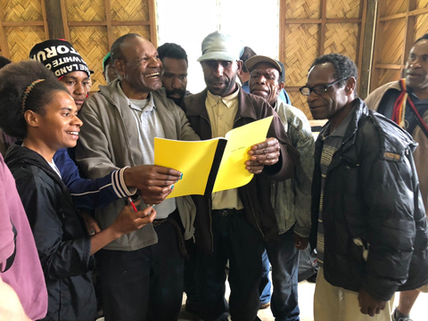
Ability
Authority
Responsibility
Translators are accountable to:
God
Their community
Accountability

Slide 7


